Slide 1

PILLARS & METRICS
PRE PURCHASE
EVALUATION
BEST PRACTICES

Slide 2
COMMITTEE:
PHIL STEARNS
Stevens Aerospace and Defense
GEORGE KLEROS
Jet Support Services, Inc.
MARK THIBAULT
Crew Chiefs
ZACH UNGERLEIDER
ACASS
DELRAY DOBBINS
Engine Assurance Program (EAP)
BECKY MARES
JetRep
BRAD HARRIS
Dallas Jet International
JIM RINER
Wetzel Aviation
JOSH PERKINS
West Star Aviation
TRAVIS FLESHMAN
Stevens Aerospace and Defense
CHRIS BUCHOLZ
Crew Chiefs
REPRESENTING NBAA:
DOUG CARR
NBAA
LEE BREWSTER
Thoroughbred

Slide 3

MAINTENANCE COMMITTEE

Slide 4
INFO GATHERING
PILLARS & METRICS
PURPOSE
To educate and guide buyers, sellers, brokers, and all those involved with the Pre-Purchase Event (PPE) with the ultimate goal of reducing time, cost,
and unnecessary risk while increasing event satisfaction with all involved to keep the process moving forward to
it’s best resolution.
ENGINE/APU
ON PROGRAM
Guidance from OEM,
SPT Runs, FOD check
NOT ON PROGRAM
Do what it would take to
get them on a program
DECISION MATRIX
Guidance to the next step of evaluation

Slide 5
OVERVIEW
PRE-PURCHASE EVALUATIONS are core to the aircraft transaction process. Over the years, these events have grown to become more time consuming and have, in many cases, taken on more technical activities and risk than reasonably necessary.
THESE CONDITIONS have brought the industry to a point where we thought that we should revisit the entire process and offer a more practical and financially reasonable approach to reduce unnecessary risk and make the entire process more efficient and effective for all parties.
TRANSACTION TIMELINES have steadily increased in recent years due, in part, to increased amounts of requested evaluation tasks, limited MRO availability, clarity on OEM recommendations and guidance and how that aligns or mis-aligns with expectations, as well as ongoing supply chain/parts challenges.
ALL OF THESE strain and burden the entire process for all parties involved.
Too often, large-scale work scopes are initiated not because of a maintenance manual directive or a known aircraft
issue, but simply because the aircraft is changing ownership.
THIS PRACTICE is inefficient, prolongs the transaction process, and creates unnecessary burdens.

Slide 6
DISCLAIMER
The information contained in these aircraft pre purchase best practices, is provided solely to the membership of IADA and NBAA for the purpose of providing considerations for our membership to think through when planning for aircraft pre purchase evaluations.
These best practices are not intended to be and do not claim to be definitive.
While input has been sought, and included from relevant original equipment manufacturer, “OEM” providers, this document does not replace the OEM provider’s guidance regarding pre purchase evaluations; the OEM provider’s guidance remains the definitive standard.
The information provided herein is not professional legal advice and the information provided herein does not create an advisory or attorney client relationship between IADA or NBAA and the user of this document.
The information contained herein is provided “as is” and may not always be complete or current.

Slide 7
STANDARDIZED DEFINITIONS

Slide 8
Scope of Work for Hangar Survey/Visual Evaluation
Determine Level of Evaluation for Pre Purchase Survey

Slide 9
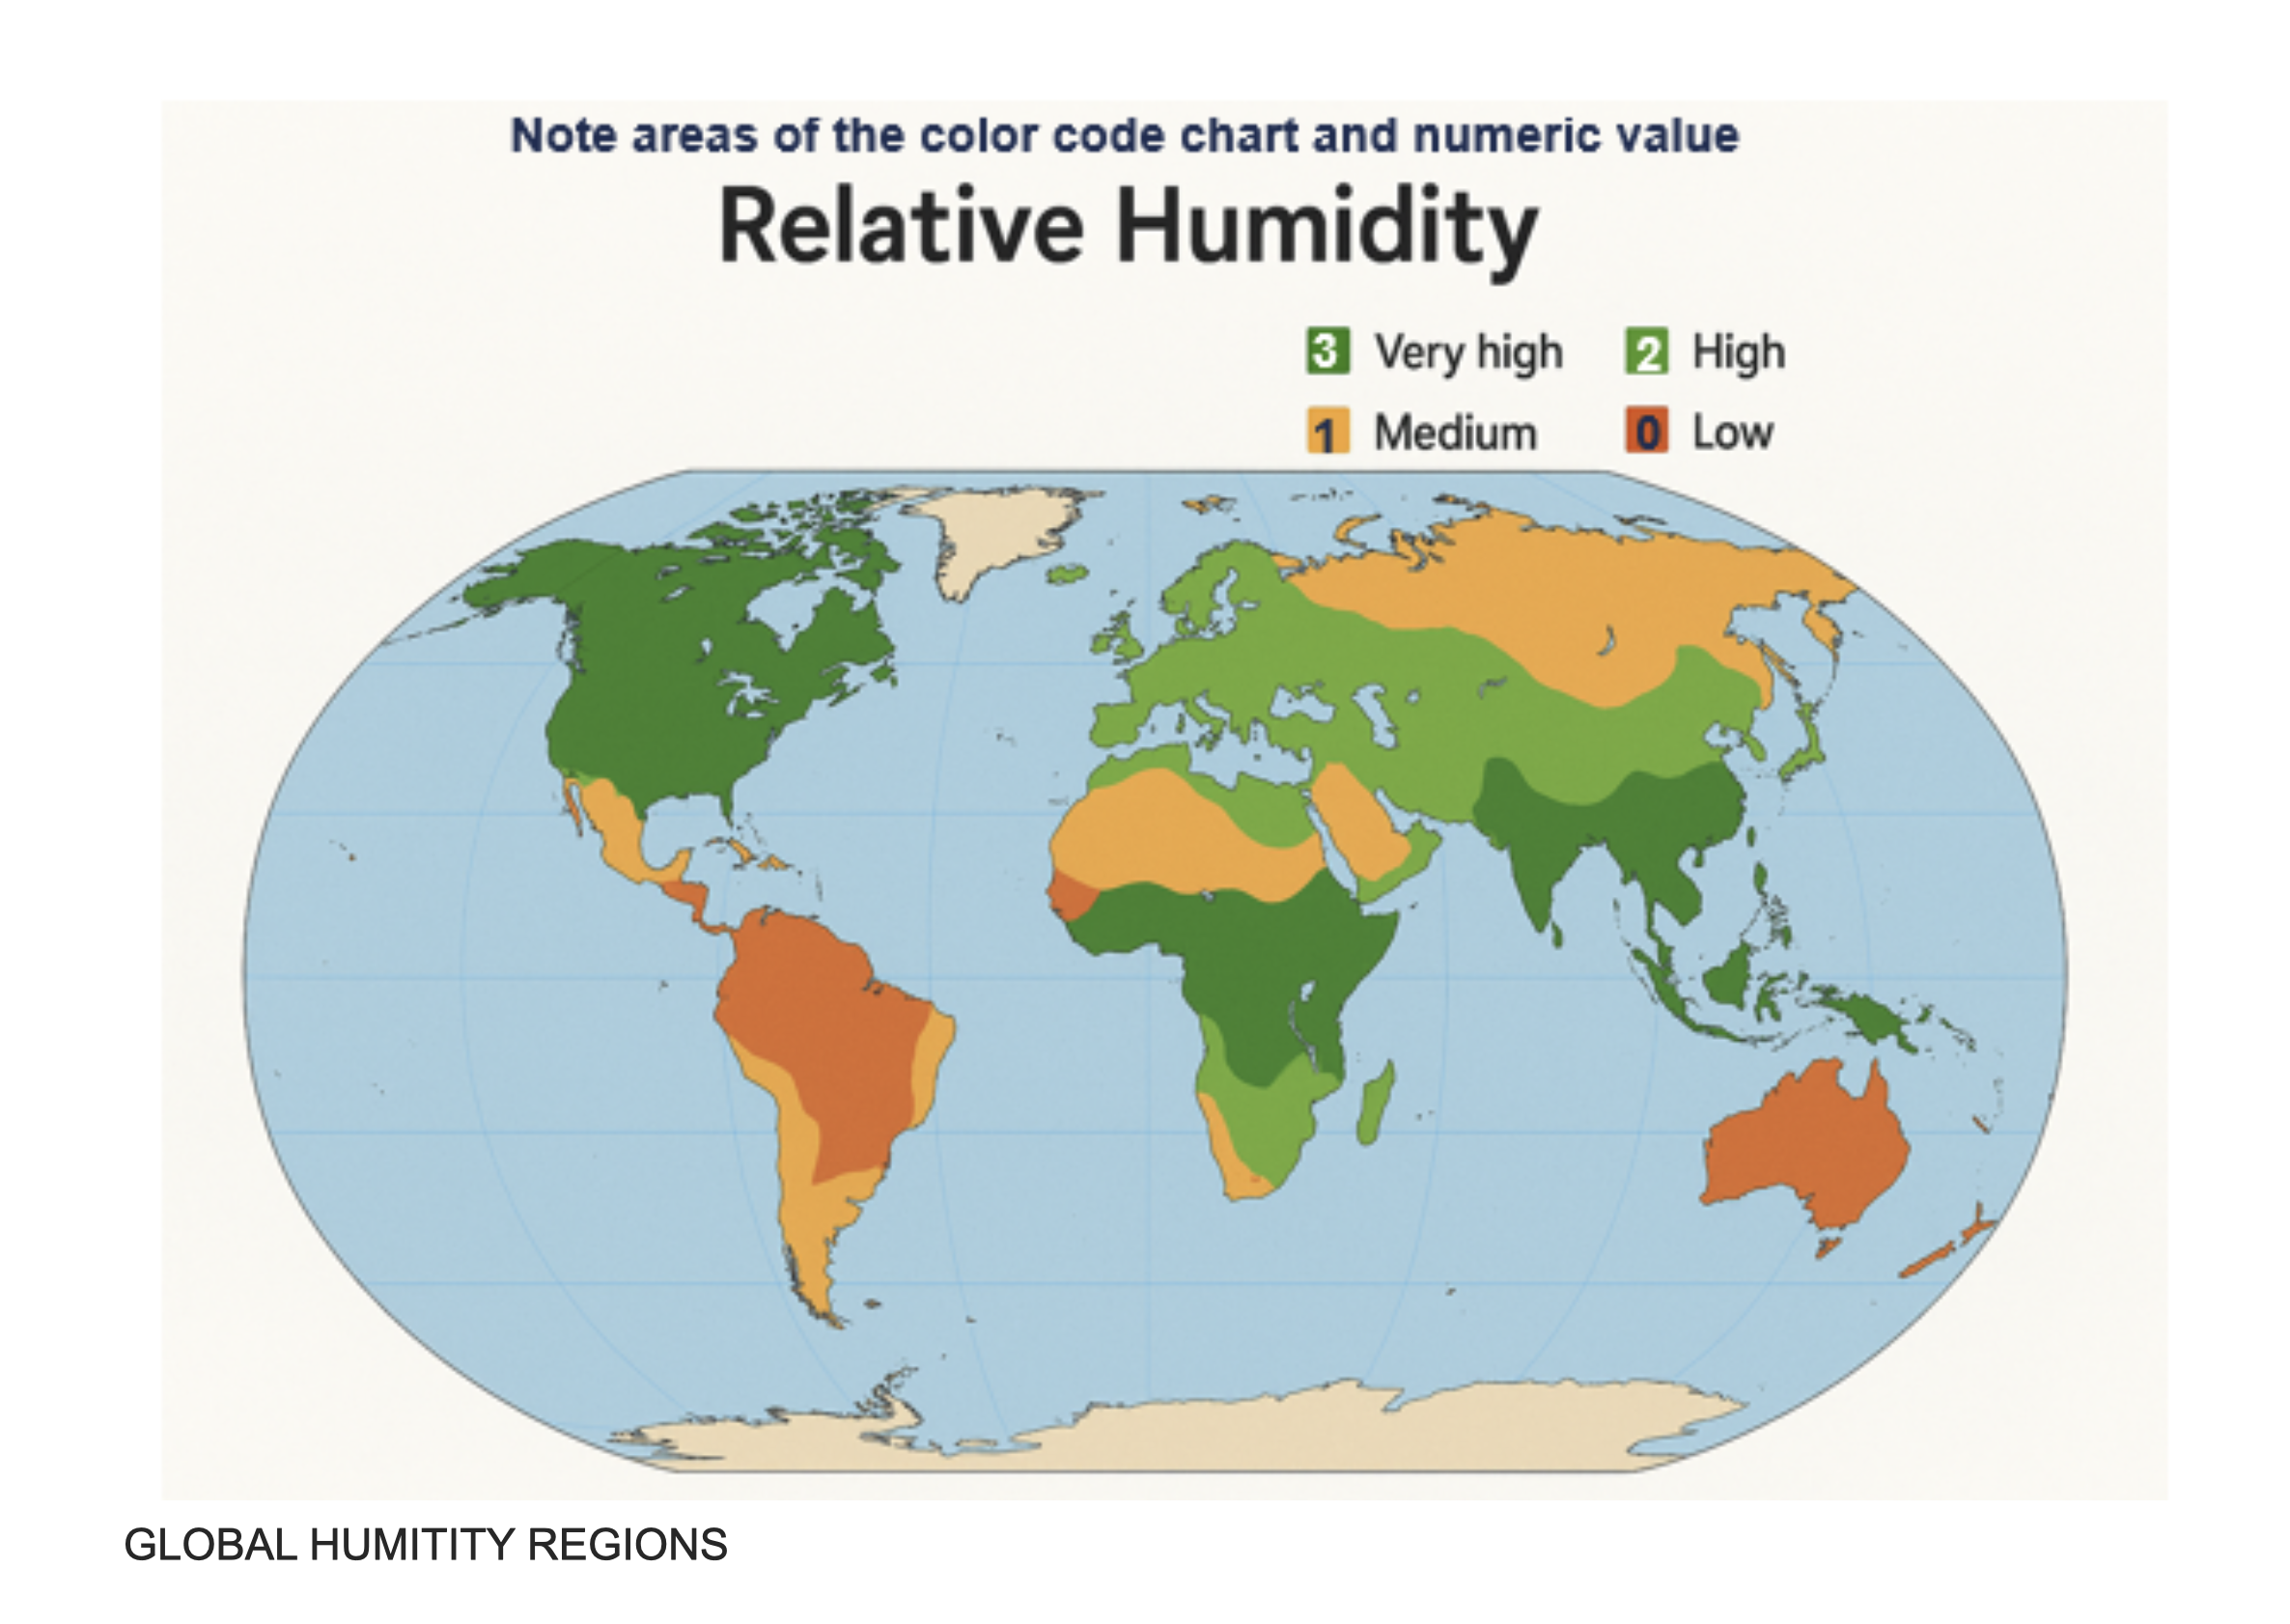
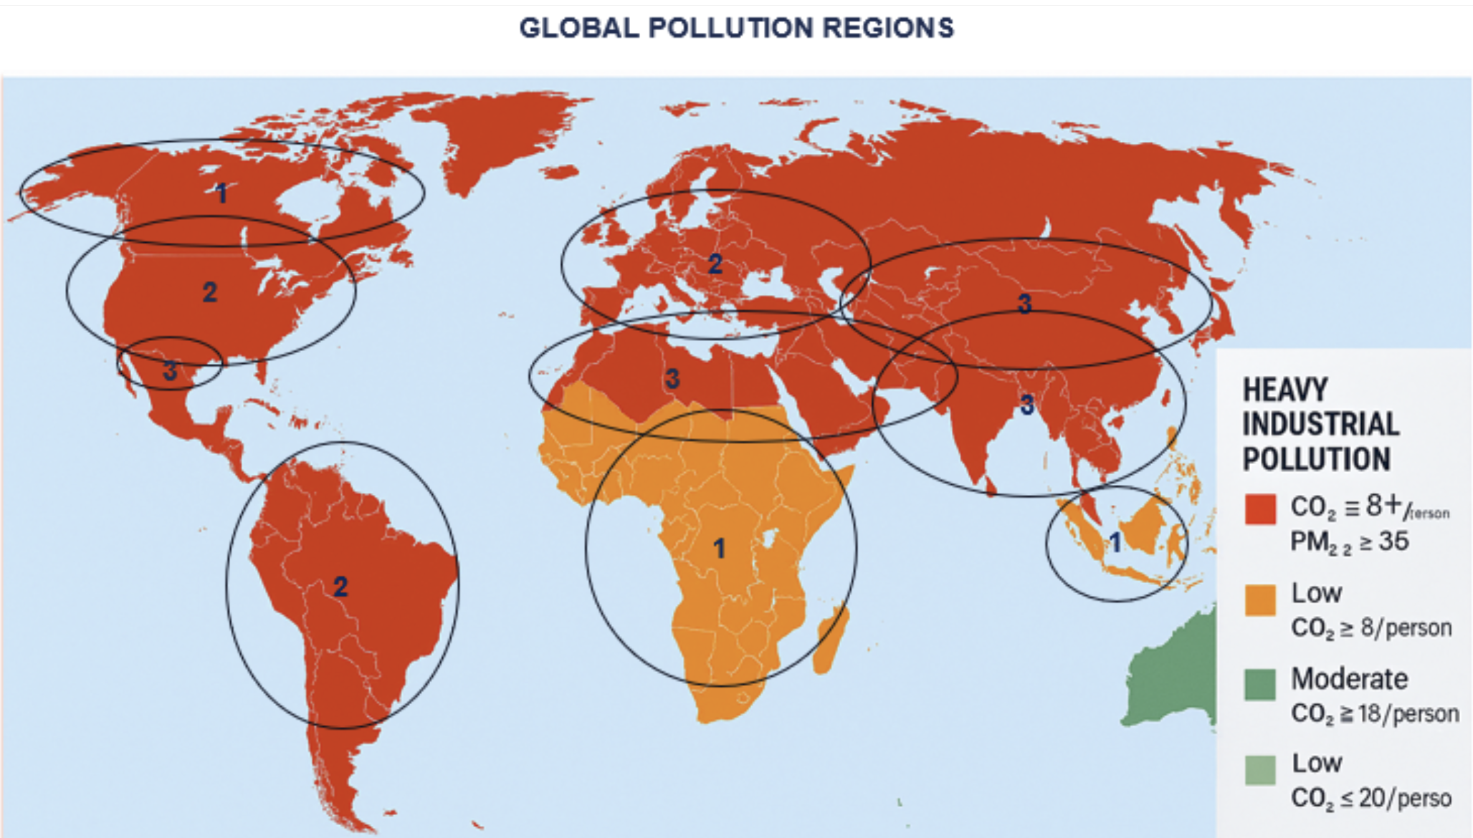
EVALUATION / RISK MANAGMENT

Slide 10
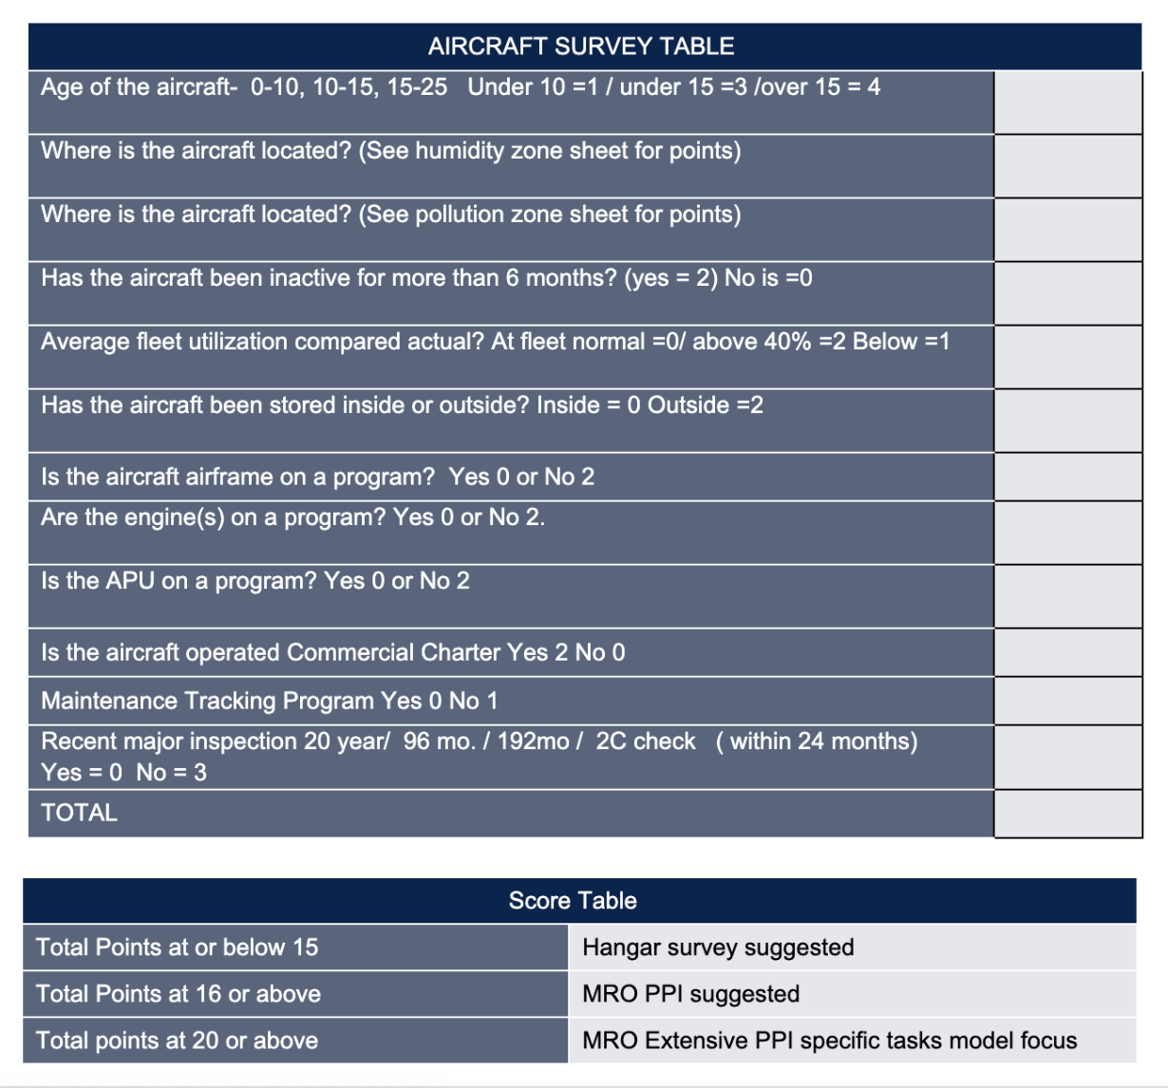
AIRCRAFT SURVEY MATRIX

Slide 11
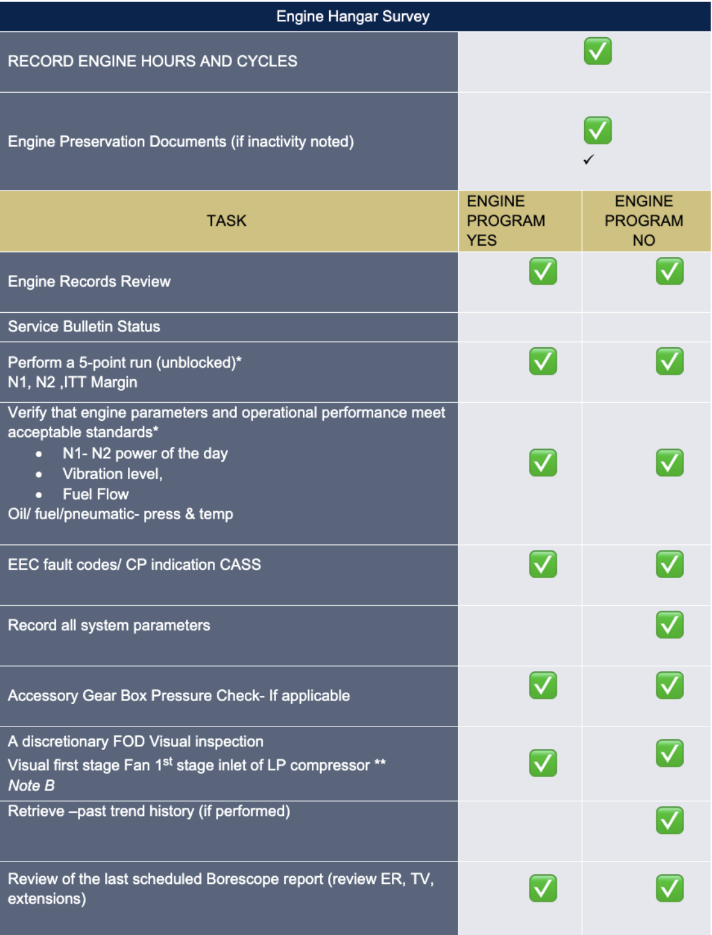
ENGINE HANGAR LIST

Slide 12
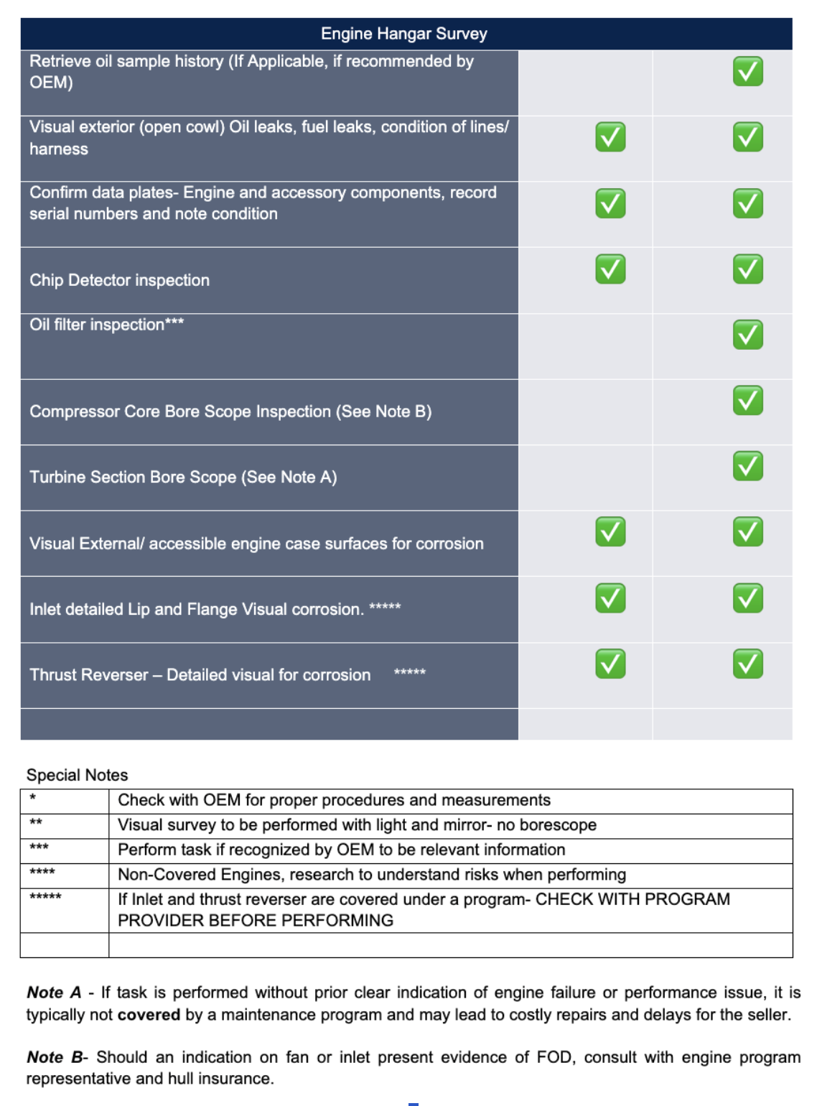
ENGINE HANGAR SURVEY

Slide 13
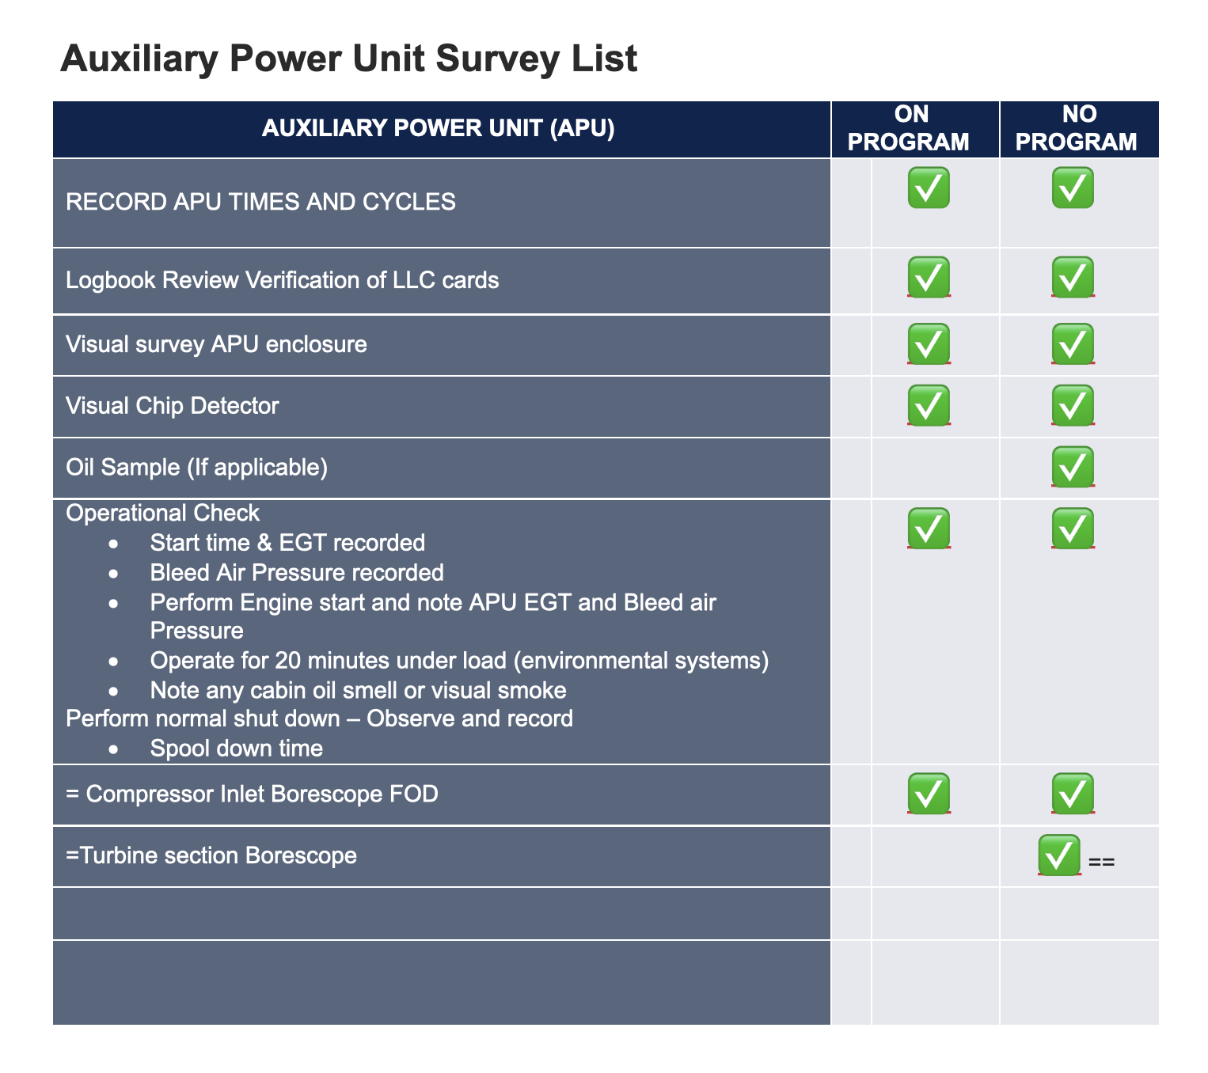
AUXILIARY POWER UNIT SURVEY LIST

Slide 14
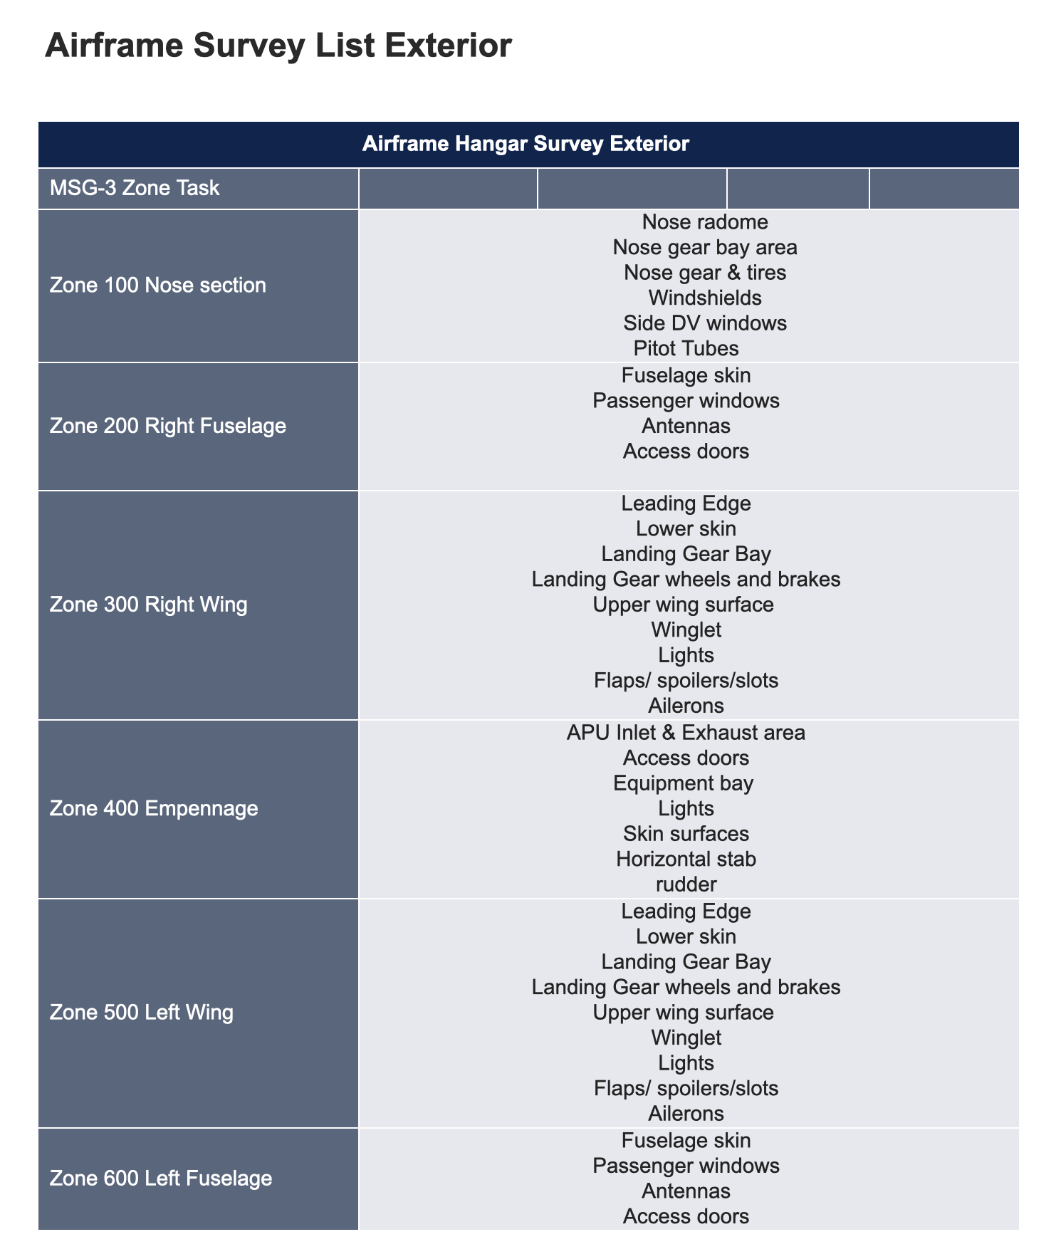
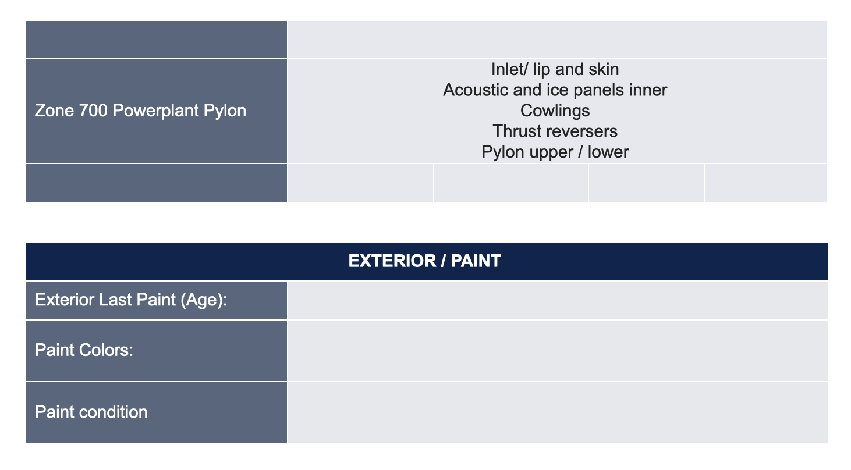

Slide 15
AIRFRAME SURVEY LIST EXTERIOR

Slide 16
GUIDANCE FOR HIGHER LEVELS
OF EVALUATIONS
BEST PRACTICES

Slide 17
ANTICIPATED SCHEDULE
FALL MEETING PRESENTATION

Slide 18
DOCUMENT WILL BE AVAILABLE ON THE MEMBER DASHBOARD
COMING SOON COURSES

